Slide 1


Python Training
Module 1 - Installation and Basics

Slide 2
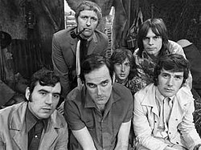

Python
Python is a high-level programming language that has been around since the early 90s, but has particularly come to prominence in the last 15 years. It is now the most widely used language in the world.
A key feature of Python is that it is highly extensible. This means we can bring in code that others have written to extend the core functionality of Python (we saw that in the last session when we talked about packages).
Python also allows us to get quick results and build iteratively making it perfect for scientific computing (such as modelling and data science).
Yes it really is named after Monty Python

Slide 3
Writing Python Code
When we write code in Python, we can do so in one of three ways :
By issuing commands to the computer that are carried out immediately. We do this via something known as the iPython Console, and we typically do this when we want to test things out quickly, or interact with our program ‘live’ in some way.
By writing programs (or scripts) that contain a series of instructions for the computer written in Python. The instructions won’t be carried out until we run the program, at which point the Python interpreter will go through our code line by line and issue commands to the computer. We store such programs / scripts as .py files.
By writing blocks of code in a Jupyter Notebook. We’ll talk more about these later.

Slide 4
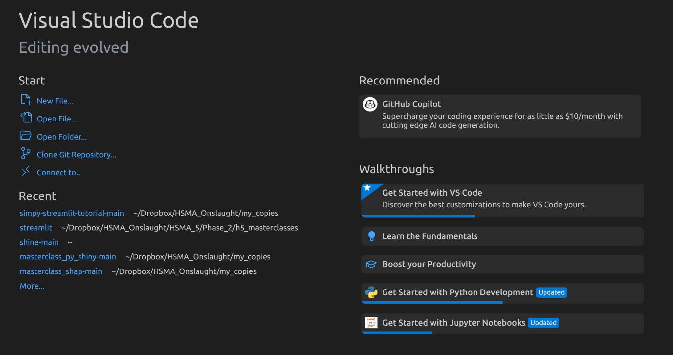
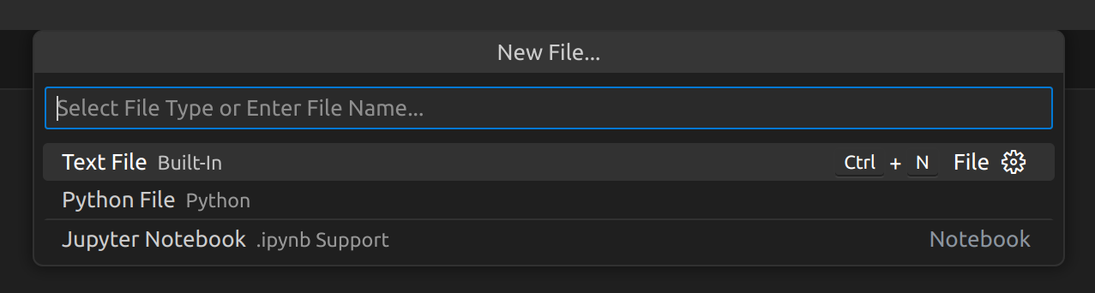
.py Files
Let’s start by having a look at how we’d create a Python program or script - the most common way you’ll write Python code.
In VSCode, we select the option to create a new file, and then select the Python File filetype from the drop down menu that pops up at the top.

Slide 5
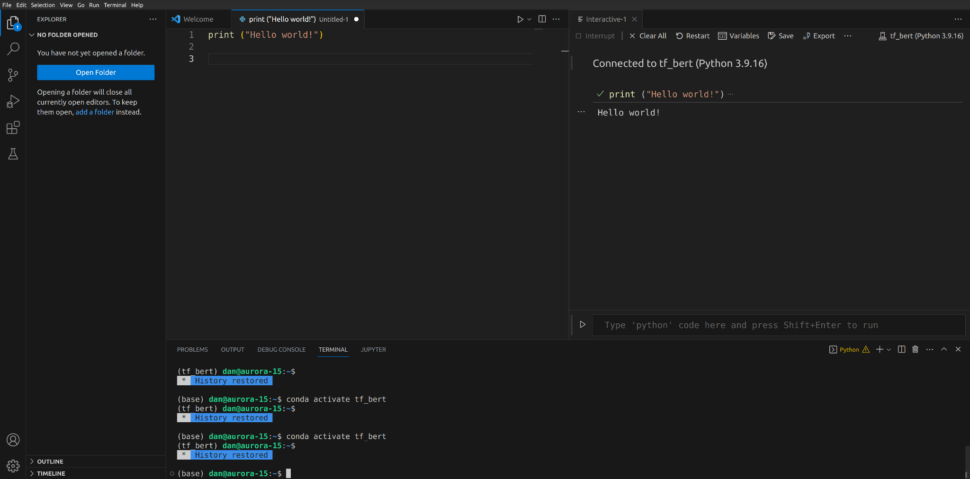
The Layout of the IDE
This is the Editor pane and contains our program / script (with each script in a separate tab at the top). This is where we write our code. Each line of code has a line number so we can find specific lines easily.

Slide 6
The Layout of the IDE
This pane contains the iPython console. This will display outputs from our code and logging messages. It’ll only appear if we run the program in an “Interactive Window” using the dropdown next to the play button in the editor pane.

Slide 7
The Layout of the IDE
We can also type code directly into the iPython console and use Shift+Enter to run the code immediately

Slide 8
The Layout of the IDE
This bottom pane has different tabs that are useful to us. It may not appear by default - use View > Terminal to bring it up. The default tab is Terminal - this allows us to interact with the OS using command line instructions.

Slide 9
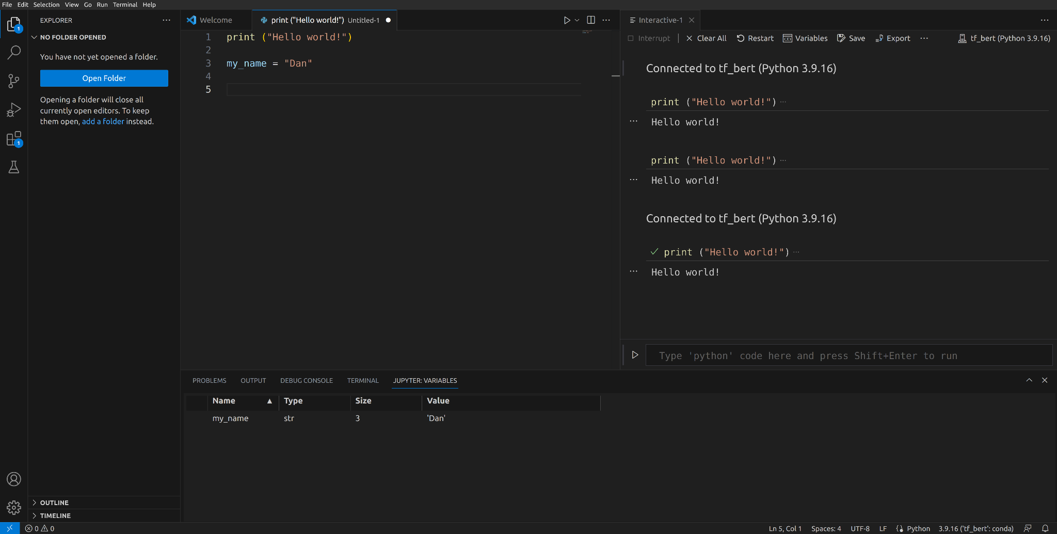
The Layout of the IDE
Jupyter: Variables allows us to keep track of variable values that have been stored in memory when our code runs. Outputs and Debug Console offer some more advanced features that we won’t cover at the moment.

Slide 10
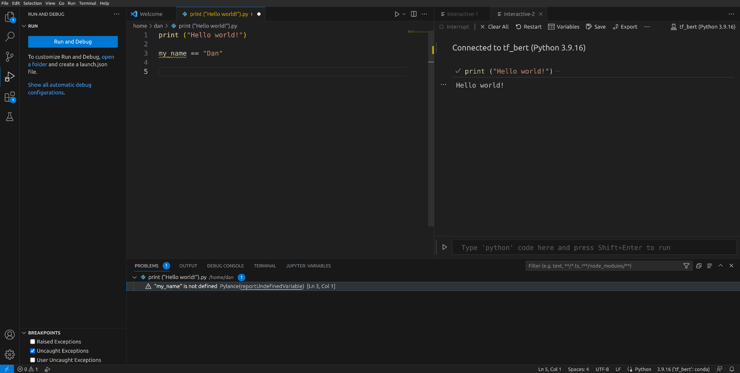
The Layout of the IDE
Problems will try to flag up any identified problems with the code that we’ve written in the Editor before we run it. You can see the yellow squiggly line under my_name in the Editor. Yellow lines = warnings (ie the code might run but you may have problems). Red lines = errors (the code won’t run, usually because of a syntax error).

Slide 11
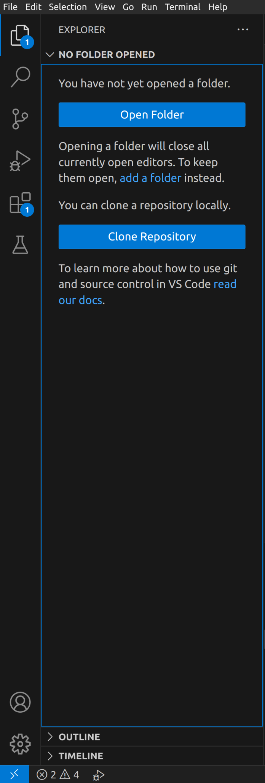
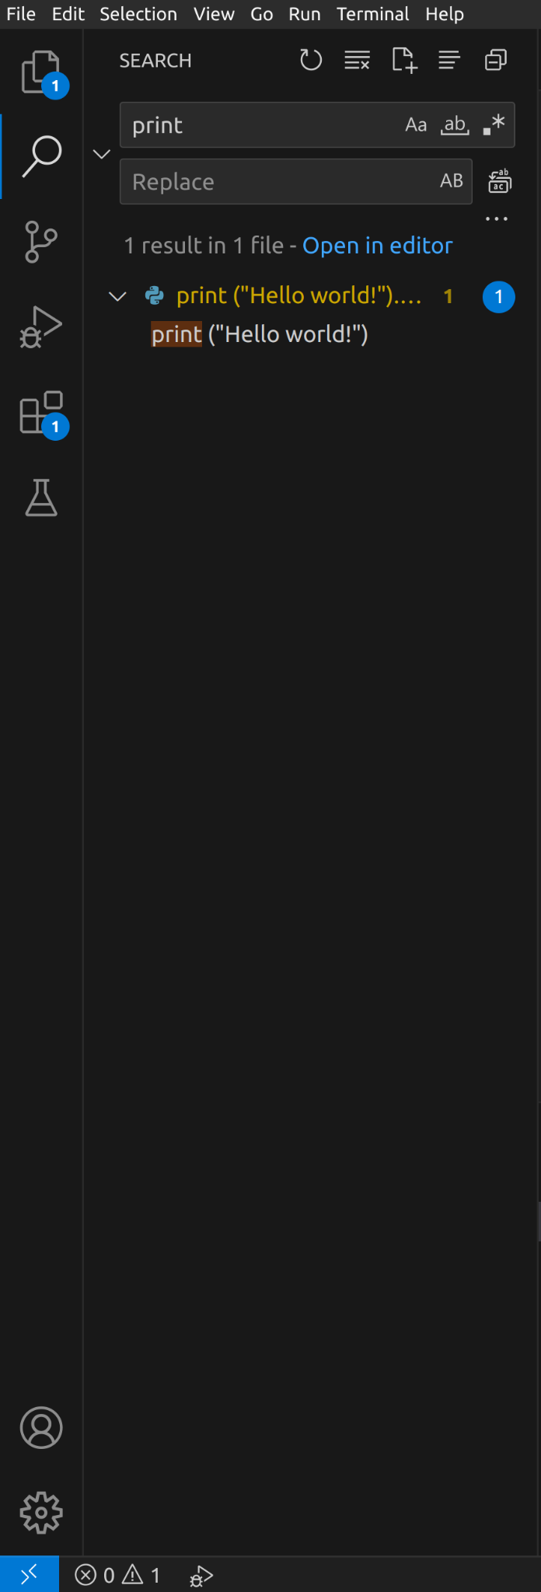
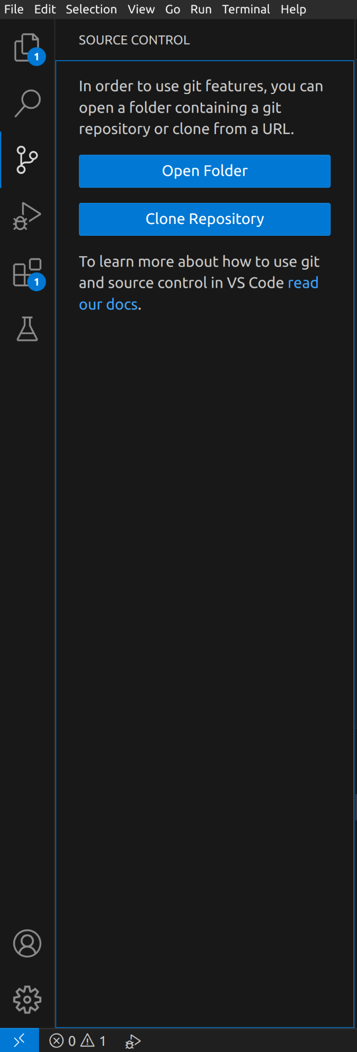
The Layout of the IDE
The sidebar on the left allows us access to different information depending on the button we push. Explorer allows us access to the files if we open a folder of files so we can easily jump between them.
Search allows us to find (and optionally replace) text in our code
Source Control allows us to use Git (version control) features. Don’t worry right now. We’ll get to Git later in the course when you’re more prepared…
You’ve already seen Extensions. Don’t worry about the other two for now.

Slide 12
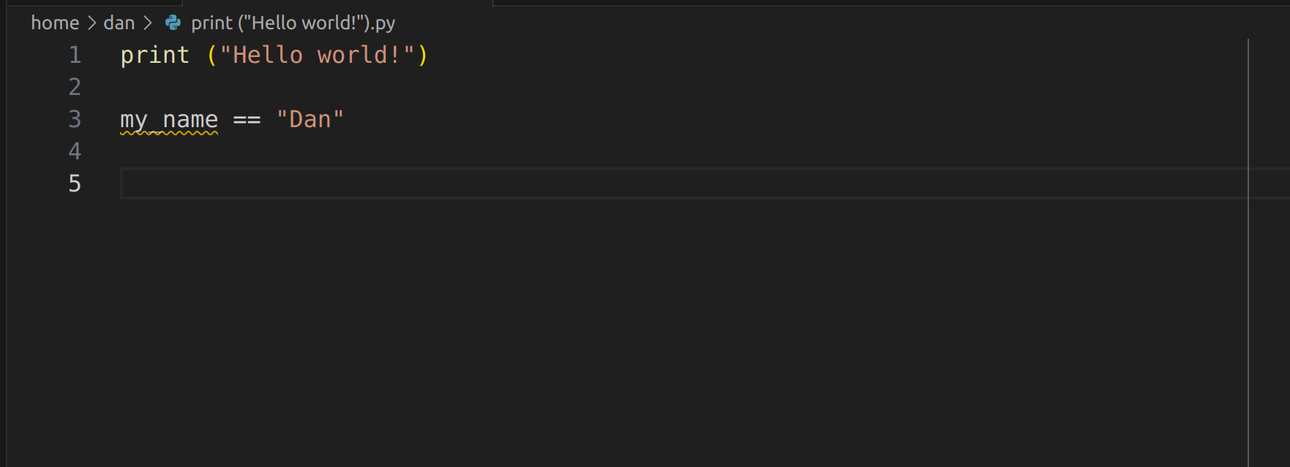
The Line
In the previous screenshots, my view was zoomed in to make the captures easier to read. But if I zoom out to my natural view, you’ll see a vertical line in the Editor pane…

Slide 13
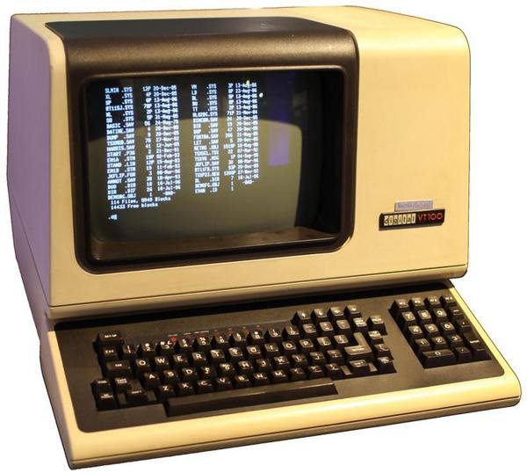
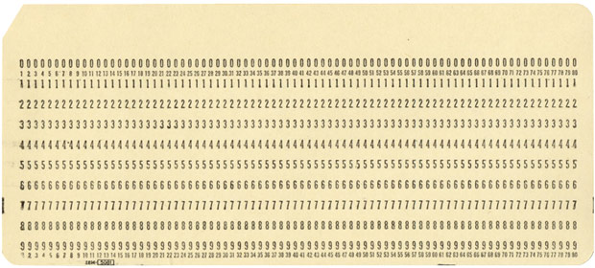
Grandad’s off…
The line in my editor pane indicates a width of 80 characters.
Back in the old days, old terminal monitors had a standard width of 80 characters.
Back in the even older days, when programs were run on punch cards, and computers were bigger than your house, the IBM punch card had 80 columns.

Slide 14
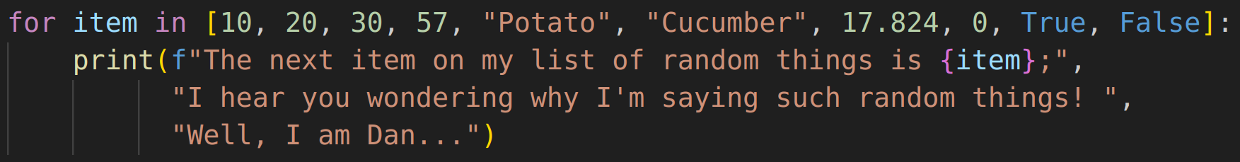
Don’t cross the line whippersnappers…
Whilst at least most of us no longer routinely use punch cards or 80 character terminals in our IT setup, an 80 character width makes code far more readable for others (and for you!).
It’s extremely bad practice to cross the line.
I don’t care if it’s 1 character over, or 100. It does matter! In fact, if you want to be compliant with PEP 8 (a widely adopted style guide to improve readability and consistency of Python code), you must adhere to it. And it’s good to get into the habit of good coding practice from the off.

Slide 15
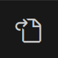
Put in the line
By default, VSCode does not contain the line. But we can add it. It’s a bit fiddly, but we only have to do it once.
First, go into File > Preferences > Settings (or just hit CTRL + ,)
Then click the Open Settings (JSON) button on the top bar

Slide 16
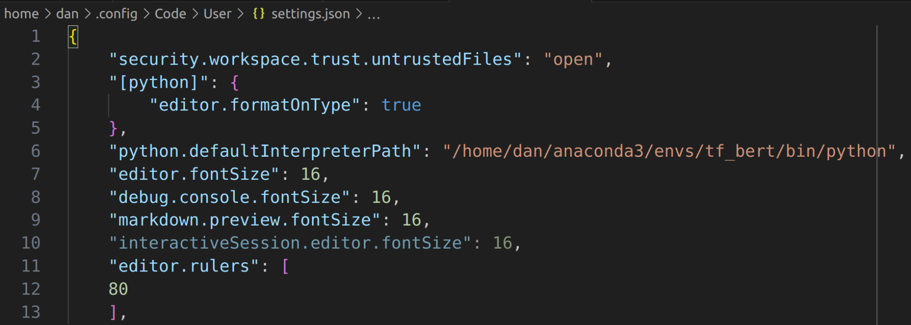
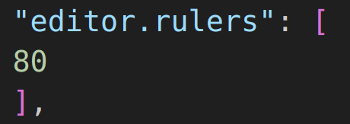
Put in the line
Your JSON file may well look different, but the key thing is you need to add in
before the } (and you’ll need to add a comma to the end of the previous setting if there isn’t one there already)

Slide 17
Implicit Line Continuation
You may be wondering how you avoid crossing the line - surely there must be certain situations where a line of code is going to be longer than 80 characters?
The easiest (and PEP 8 recommended) way to avoid it in Python is to split a line using something called implicit line continuation. This happens where Python sees the use of a bracket :
(, [ or {
but it has not yet been closed. If you hit ENTER, Python will assume you’re still writing the same line of code.

Slide 18
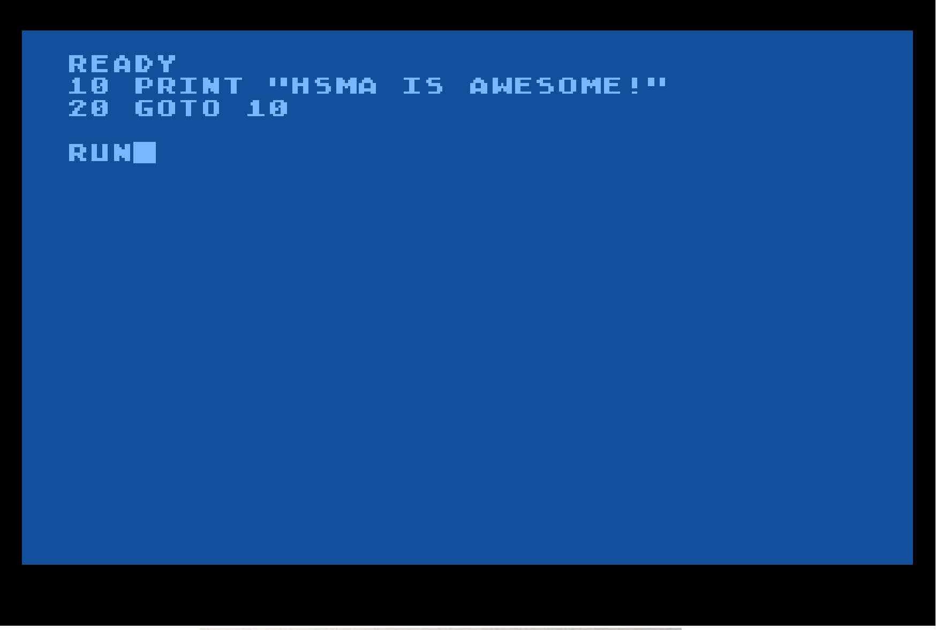
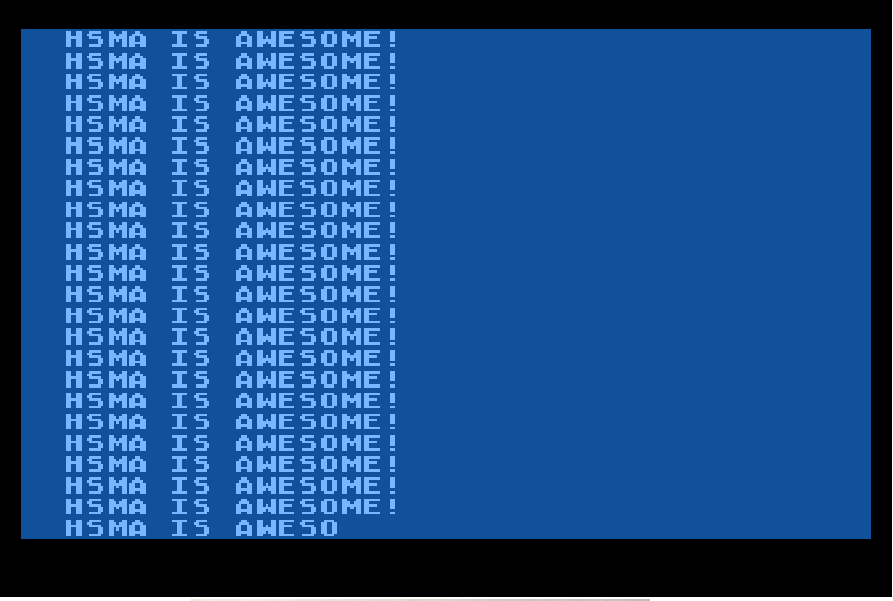
I’m sorry to interrupt…
Sometimes when you run code, you may find yourself stuck in something known as an infinite loop. This is where the code we’re running is going around in circles with no way out…
Those of you of a certain age may remember deliberately writing such loops (possibly in your nearest branch of Boots or WH Smith) on early home computers…

Slide 19
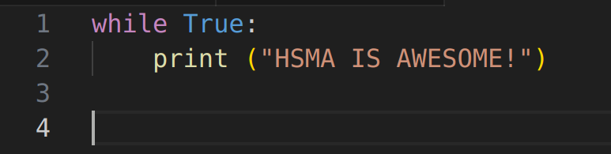
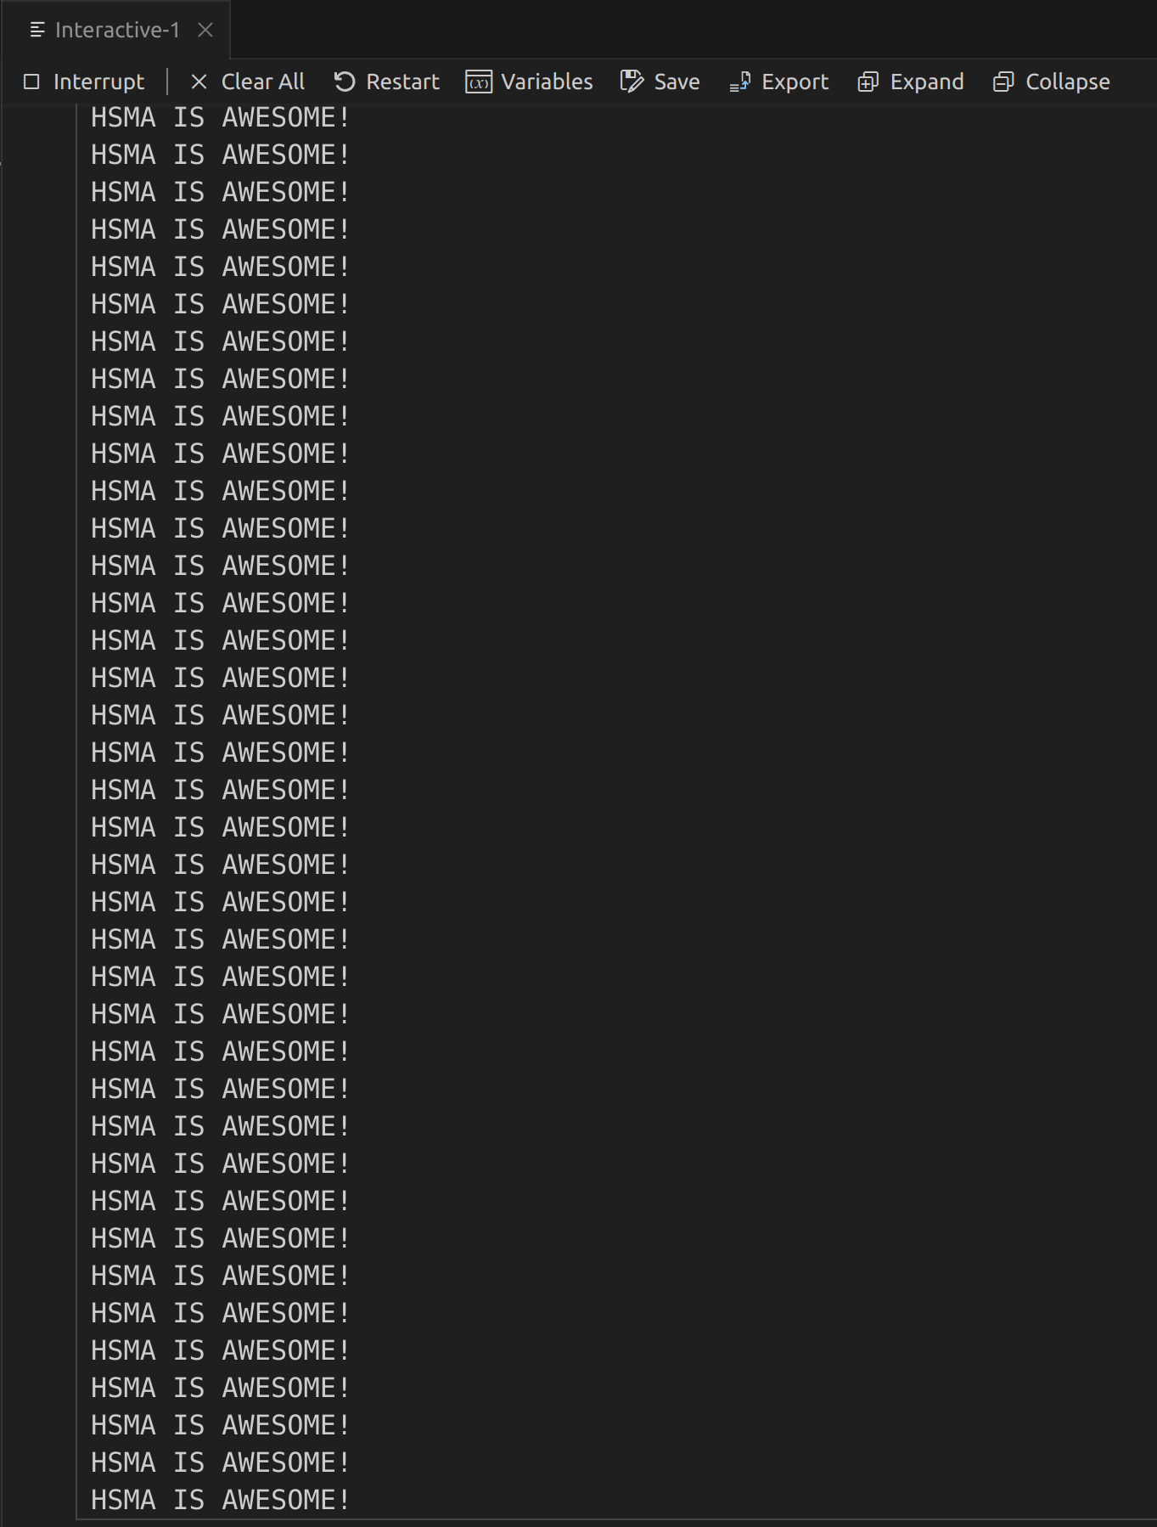
I’m sorry to interrupt…
Sometimes we want to write infinite loops (you’ll see examples in the course), but usually it means we’ve done something wrong in our code, and we need to escape. To do this, we can interrupt the execution of the code.
In VSCode, when running a file in an Interactive Window, we can simply click the Interrupt button at the top. Sometimes that won’t work (it politely asks the code to stop) - if it doesn’t, you can use the Restart button to restart the Kernel instead (we’ll come back to that in a bit).

Slide 20

Python Packages
Python is one of the most popular programming languages in the world. It’s easy to learn, great for data science and receives a lot of development attention.
Packages in Python are bundles of code that we can install and use to allow us to perform certain tasks. For example, the SimPy package (which we will use in this course) provides us with a framework for building Discrete Event Simulations in Python.
To install packages, we need to use a Package Manager. A package manager installs packages from various sources. The built-in package manager in Python is pip (which mainly gets packages from the PyPI.org repository - the Python Package Index). pip is an acronym that stands for “Pip installs Packages”. This is known as a recursive acronym, and is widely considered amongst computer scientists to be a form of humour.
I’ll just wait for you to stop laughing…

Slide 21
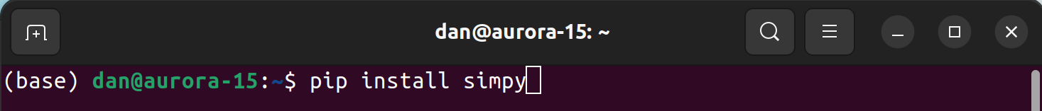
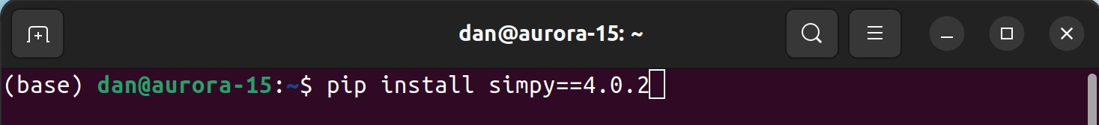
Toodle pip
To install a package using pip, we use either the terminal (either the one in VSCode, or if you’re using Linux / Mac, you can start up your own separate terminal in the OS), or, if you’re using the Anaconda distribution (as we are in this course - more on that shortly), you can also use the Anaconda Prompt.
We simply provide the command pip install followed by the name of the package we want to install.
By default, the most recent version in the repositories being used by pip will be installed, but you can specify a specific version if you prefer (note the == : you need double equals for pip) :

Slide 22
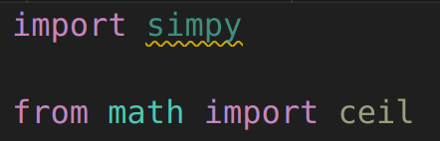
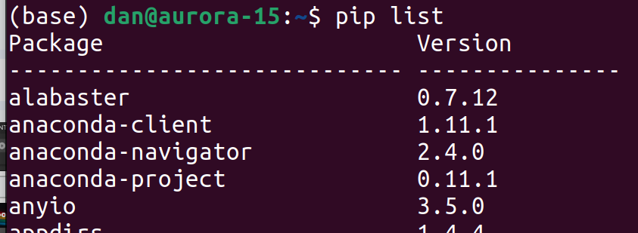
Toodle pip
Once we’ve installed our package, we can use it in our Python programs whenever we like by simply importing either the whole package, or just the bits we need in our program. We’ll cover imports in the Python training.
We can list the packages that we’ve got installed using pip list.
And uninstall packages using pip uninstall.

Slide 23
Python Requirements File
Python requirements files are a great way to keep track of the Python modules. It is a simple text file that saves a list of the modules and packages required by your project. By creating a Python requirements.txt file, you save yourself the hassle of having to track down and install all of the required modules manually.
You can also generate a Python requirements.txt file directly from the command line with: pip freeze > requirements.txt
To add more packages to the requirements file, add the names of the modules you want to install, one per line, specifying the version if required.
Example:
tensorflow==2.3.1
uvicorn==0.12.2
fastapi==0.63.0 Save the file after adding all the necessary modules and close the document once done.

Slide 24
Installing Python Packages From a Requirements File
Why Use pip install?
Simplifies package management.
Ensures all required dependencies are installed for your project.
Steps to Install:
Open a terminal or command prompt.
Navigate to your Python project directory.
Run the command:
pip install -r requirements.txt
Outcome:
All modules in requirements.txt are installed in your project environment.

Slide 25

Jupyter Notebooks
Jupyter Notebooks (.ipynb) are a type of document, much like a Word document (.docx) or a Portable Document File (.pdf).
The key aspects of Jupyter Notebooks are :
- they are an open format
- they are made up of cells
- each cell can contain either narrative text / images (markdown) or a block of Python code that can be executed
Because of the above, they’re great for sharing code (so you can explain what your code does in a friendly way), or for teaching!
VSCode can open Jupyter Notebooks, as long as you installed the Jupyter extension.

Slide 26
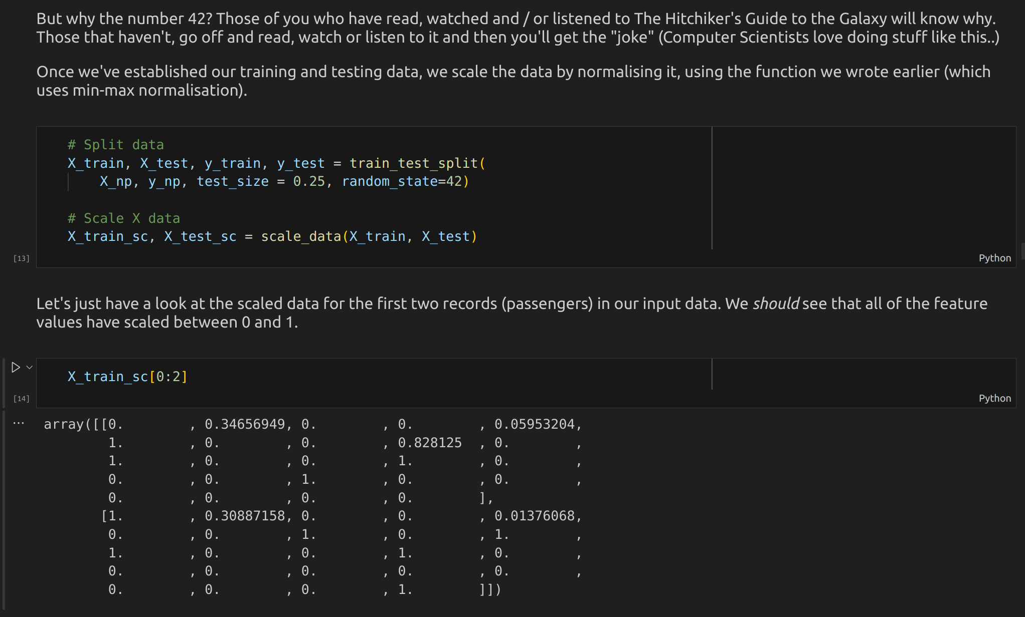
Jupyter Notebook Overview
Markdown cells : These are cells that contain formatted text, images, even videos that narrate the code.
Code cells : These contain blocks of code that are run individually, and can be run in any order.
Outputs : These are the outputs for the code cells, with each output sitting just below the code cell. They’ll only appear once an output is generated. Not all code cells will generate outputs.

Slide 27
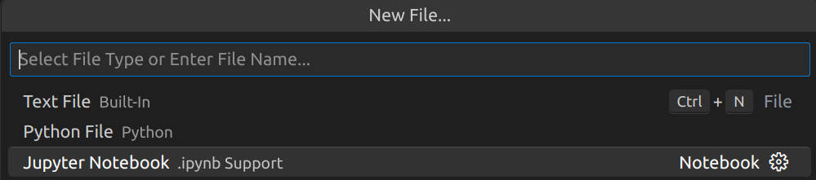
Jupyter Notebook Demo
Let’s now create a Jupyter notebook in VSCode and demo how they work. First we select File > New File, then select Jupyter Notebook.

Slide 28
Jupyter Notebook Demo
When we first create a Jupyter Notebook, it will give us a blank code cell. We can tell it’s a code cell, as it’ll have the language (Python here) labelled on the right.
Let’s type in some simple code and run it using the play button on the left (or by hitting CTRL + ENTER).
Whilst the code is running, a little circle will rotate, and once it’s complete, we’ll get a little tick, along with the time it took to run the cell.

Slide 29
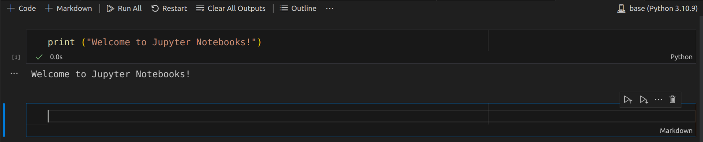
Jupyter Notebook Demo
Now let’s add a Markdown cell by clicking the + Markdown button at the top. New cells will appear below the current cell (whichever one we’re currently clicked into, or at the end if we’re not clicked into any).
We can see this is a Markdown cell, given the label on the right. In a Markdown cell we can type narrative text.

Slide 30
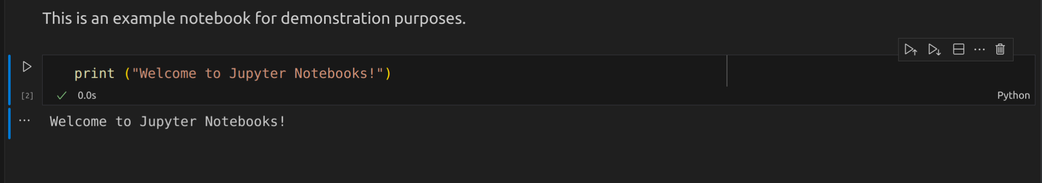
Jupyter Notebook Demo
Just as with code cells, we need to “run” markdown cells to apply any formatting (we’ll get default formatting if we don’t specify any special formatting). So let’s hit CTRL + ENTER.
We can move cells around simply by dragging and dropping them (left click on the left of the cell, hold, move, release). Let’s move our new markdown cell to the top.

Slide 31
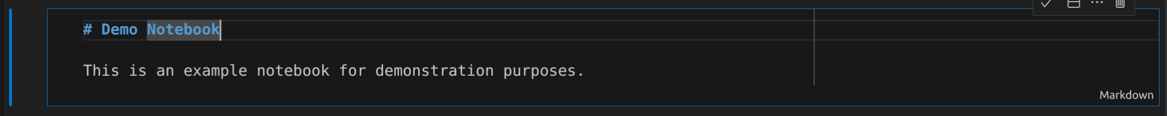
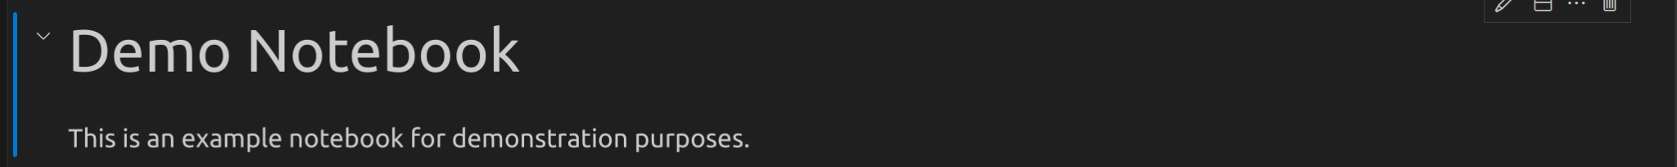
Jupyter Notebook Demo
Now let’s add some simple formatting to our Markdown cell. We’ll add a title. To edit a markdown cell, we need to double left click on it first. We’ll add a # before some text to indicate we want a title.
Let’s execute the cell to apply the formatting.
There’s lots of ways to format text in Markdown. You’ll see some examples in the exercise in a moment, which also has a useful link to a reference for markdown language.

Slide 32
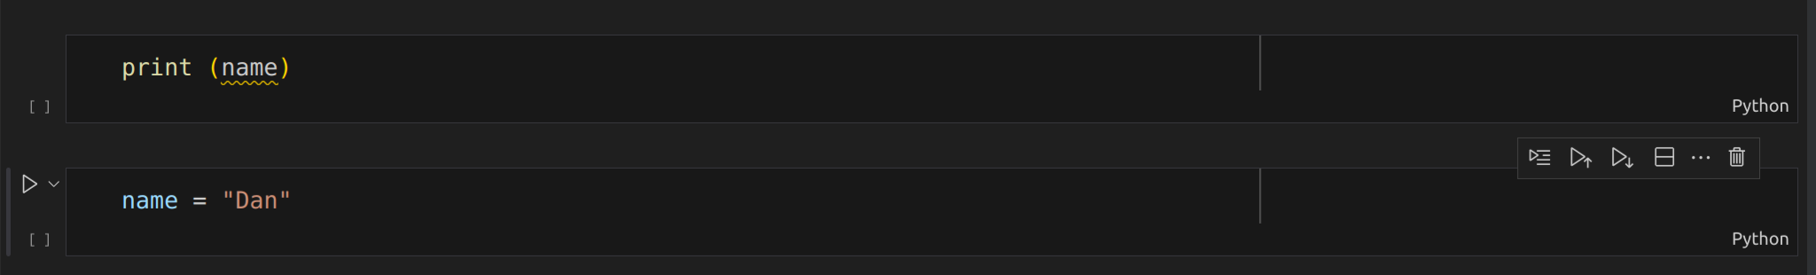
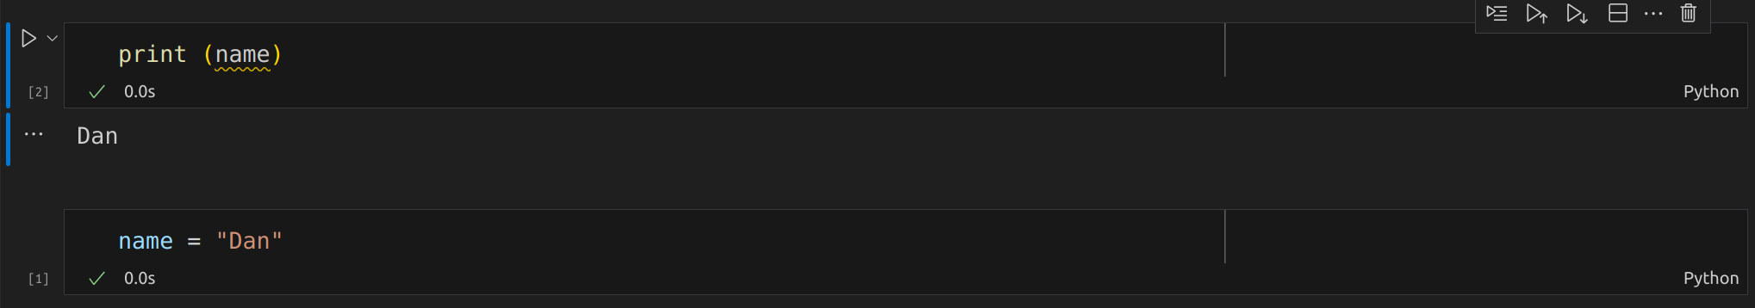
Jupyter Notebook Demo
Because we run code in individual cells in a Jupyter Notebook, they can be run in any order. This means that code may be run “out of order”. For example, this won’t work unless we run the bottom cell first :
When we run a code cell, a number appears to the left in the square brackets to indicate the order in which things have been run.

Slide 33
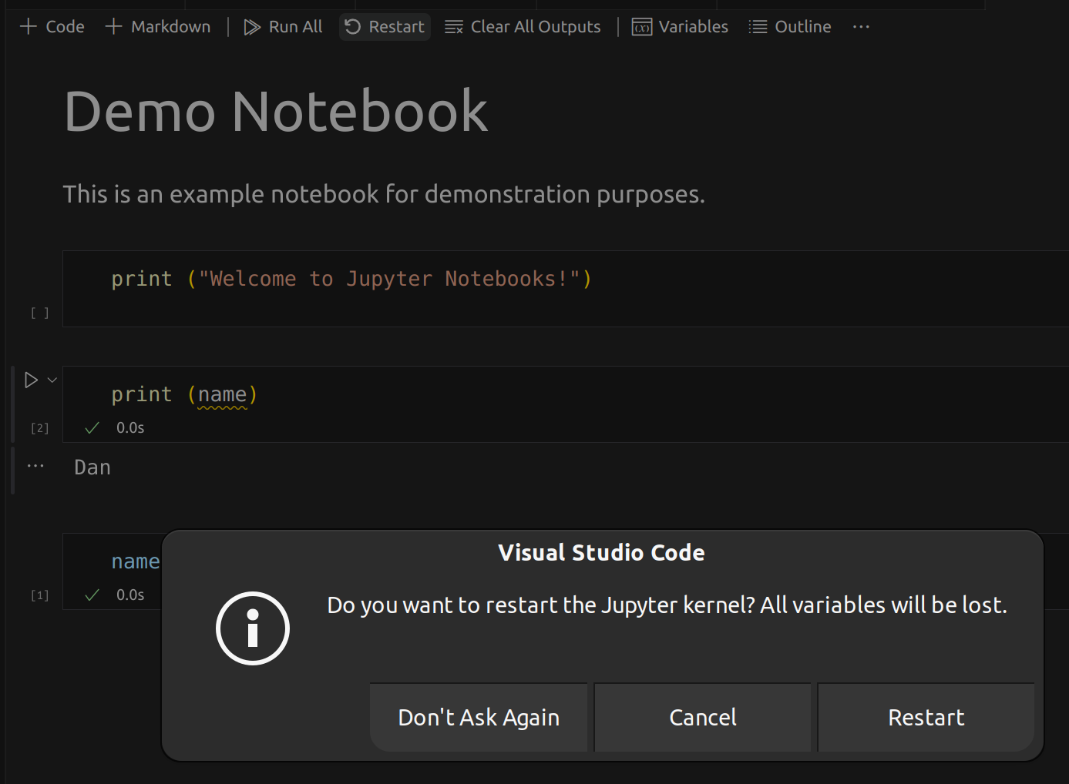
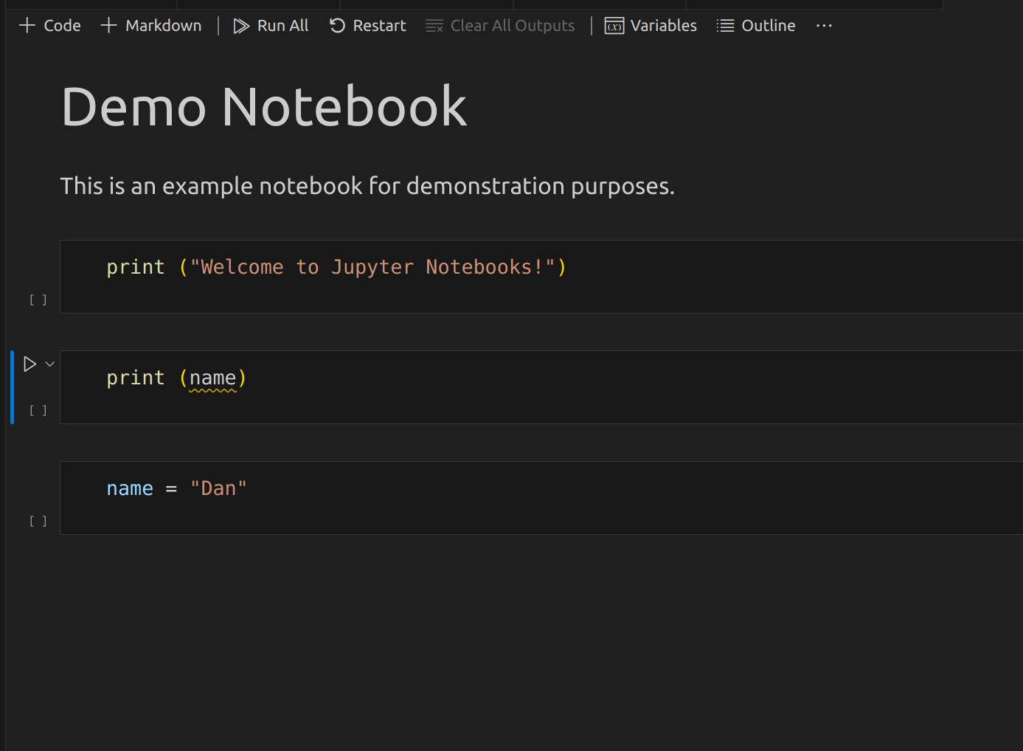
Jupyter Notebook Demo
We can restart a notebook to restart the Kernel and clear everything from memory (as though we had run nothing).
However, this won’t clear any outputs we have from code cells. If we want to clean those up too, we can then click Clear All Outputs.

Slide 34
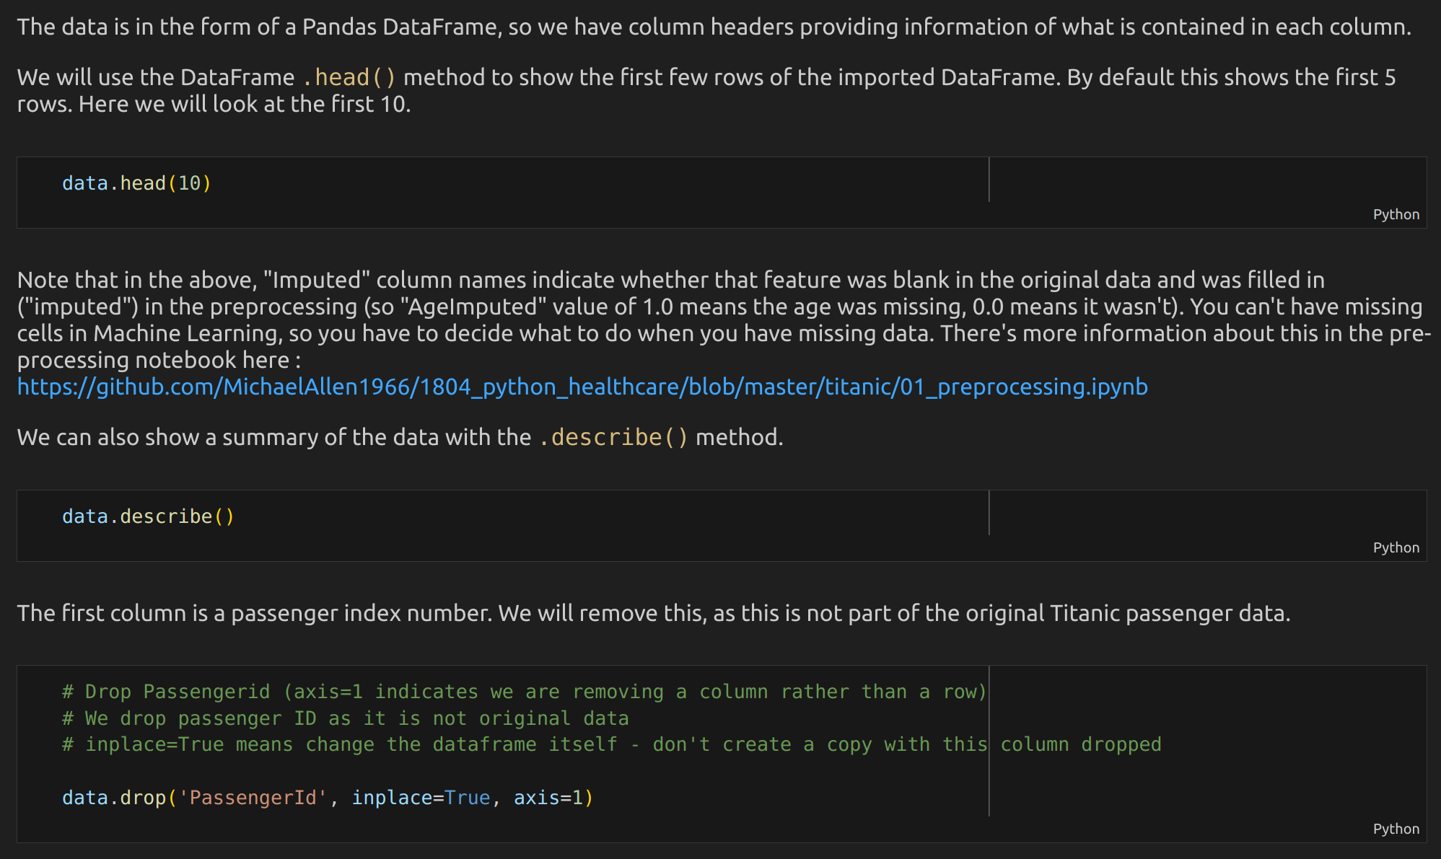
Jupyter Notebook Demo
The advantage of a Jupyter Notebook is that it allows you to provide a document that contains code that can be run but which also contains narration and visualisation to allow the user better understand how each part of the code works. This is how you should approach notebook design - don’t just create large cells of code!

Slide 35
Tea Break

Slide 36
Exercise 1
In this exercise, you'll be running a Python script to get familiar with installing packages and executing code in VSCode. Start by opening the provided exercise_1.py file in VSCode. The script will walk you through installing the required nltk package and downloading a dataset. Once the package is installed, simply run the script. As you do so, the script will display a list of words from the nltk library. This exercise will help you become comfortable with installing packages, running Python scripts, and getting output in VSCode. If you face any issues, feel free to ask for assistance.

Slide 37
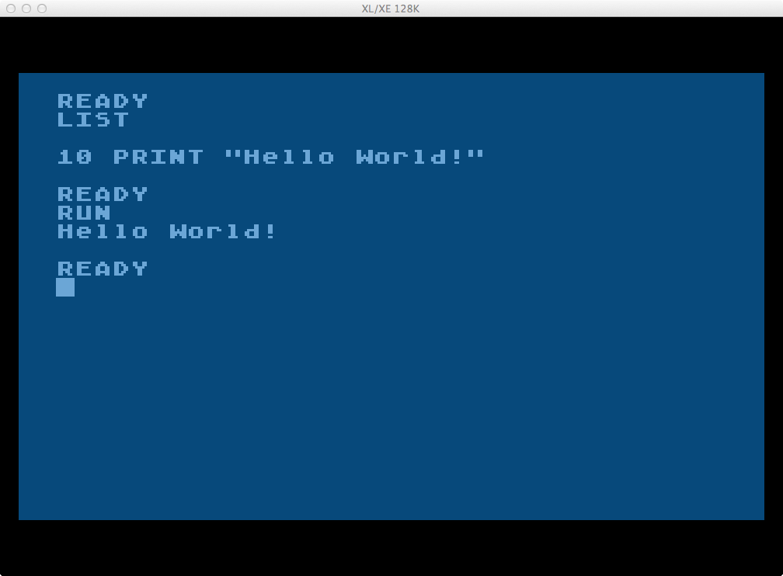
Hello World
There is a tradition in Computer Science that the first program anyone should write in a Programming Language is one that writes the words “Hello World!” to the screen.
(Look, back in my day (the 80s), getting a machine to display anything on your TV was pretty amazing stuff!)
Let’s write a Hello World program in Python.

Slide 38
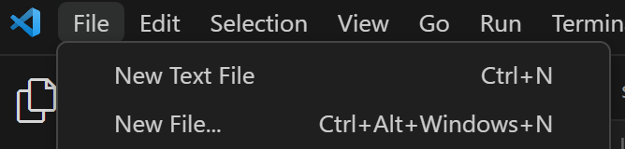
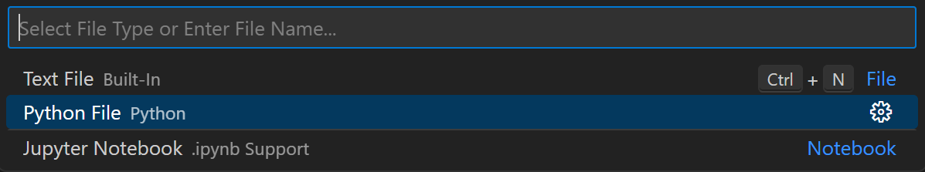
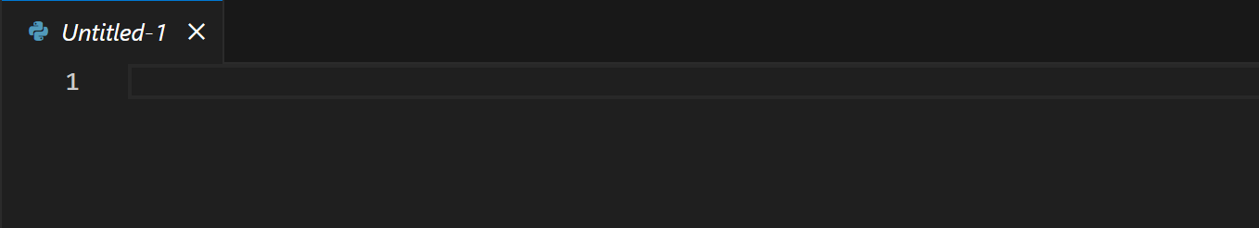
The print() Function
In Principles of Programming, we talked about functions. We said that they are bundles of code that we can run every time we call them. We can give them optional inputs, and may get some outputs.
To write text to the screen in Python, we use something known as the print() function. The input (that we put in the brackets) is the thing we want it to write to the screen.
Let’s try it in VSCode! We’ll create a new Python (.py) file.

Slide 39
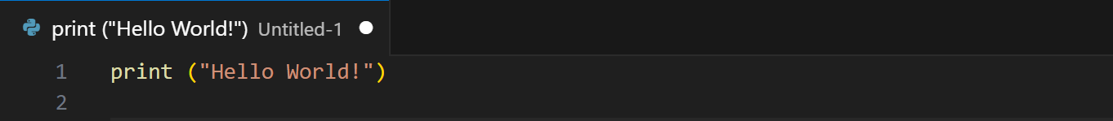
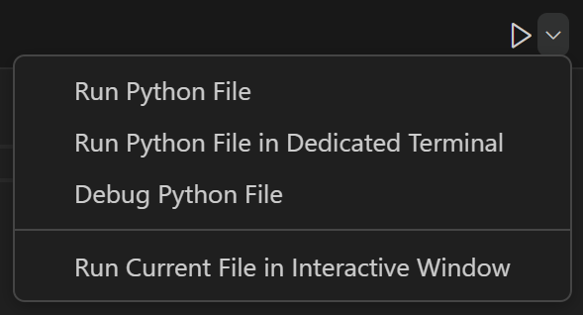
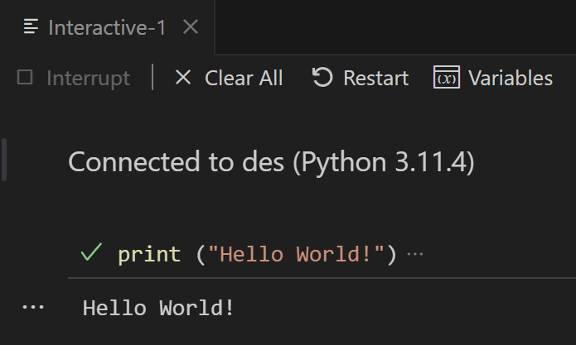
The print() Function
We use quotation marks “ to denote a string (ie text - a series of characters). We can also use single quotes ‘. Either is fine, but you must use the same one to open and close the same string.
When we type the above, nothing happens. That’s because we need to run the program.
This is exciting isn’t it. (Don’t worry, it gets better)

Slide 40
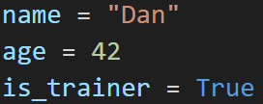
Variable Assignment
In Principles of Programming, we talked about variables. We said these are essentially boxes that store information of a certain type so the program can refer to it later.
In many programming languages, we need to create a variable by declaring it. This means specifying its type alongside its name.
In Python, things are much more laid back. Variables are dynamic, so we simply assign a value to a name to create the variable, and the type will be automatically set based on the Value we provide. We assign values in Python using the assignment operator =. It basically says “Let this have a value of this”.
This can cause confusion if you’re new to coding. = does not mean ‘equals’.
What will be the variable type of each of these variables after assignment?

Slide 41
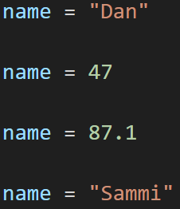
Variable Assignment
Because variables in Python are dynamic, their type will change if we give it a value of a different type :
Hi, I’m the variable name!
I’m a string!
No wait, now I’m an integer.
Sorry, I mean a float.
Apparently I’m a string again…

Slide 42


Dealing with spaces in names
In programming languages, a space indicates a separation between instructions, values etc. So if we want to name something (like a variable) with multiple words then we can’t use spaces. There are two principle conventions for how we deal with this :
camelCase
snake_case
You can use whichever you prefer (though ensure you’re consistent) but snake_case is generally preferred for (and recommended by the developers of) Python.

Slide 43
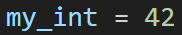
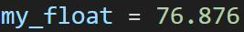
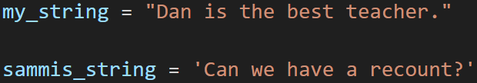
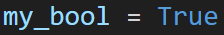
Variable Types
Let’s remind ourselves of some of the main types of variable, and see what they look like in Python.
Numbers
Integers (int) are whole numbers
Floating point numbers (float) are numbers with up to 15 decimal places
Text
Strings (str) are sequences of characters denoted using “ or ‘
(Note - Python does not have a separate variable type for characters, they are just strings of length 1)
Truth
Booleans (bool) take one of two values to indicate whether they are True or False.

Slide 44
Variable Types
Variables that store Multiple Items
Lists (list) are sequences of items, where the order matters. Duplicates allowed.
Sets (set) are unordered sequences of unique items.
Tuples (tuple) are ordered sequences (like a list) but are immutable (once created, they cannot be changed)
Dictionaries (dict) are unordered collections of key-value pairs

Slide 45
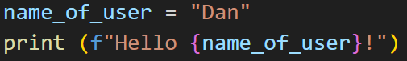
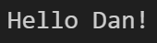
fStrings
Python has a rather neat type of string called an fString. These are strings where we can include formatting within the string to define where we want dynamic text.
We often want to do this where we want to insert the value of a variable into a string of text.
e.g. “Her name is <<insert name here>>”
To use fStrings, we simply put the character f immediately before our opening quotation mark, and use curly brackets to denote where we want to include the name of a variable, so that Python will pull in the value in that variable instead of hard-coded text.
Example :

Slide 46


More fString Features
We can also do some other cool things with fStrings. We’re not restricted to just variable names either, we can put in the curly brackets any instruction whose output will result in something that can be interpreted as a string (ie some characters).

Slide 47
User Input
Sometimes we need to ask the user to input something in order to continue with the program.
In Python, getting input from the user is easy. We simply tell Python that we need an input, any message we want to display to the user, and the name of the variable in which we want to store the input.
HOWEVER, when we read in the inputs from a user, regardless of what it is supposed to represent, they will be read in as a sequence of characters. In other words, as a string.
Clearly, if we’re reading in something intended to be a number (like an age) that’s no good. So what can we do?
Well, we are wizards…

Slide 48

Casting
Python allows us to turn one type of variable into another, like a magic spell. This is known as casting. As long as the value stored in the variable can be interpreted as the type we’re trying to cast it into, it’ll work (otherwise we’ll get an error).
To cast, we simply wrap the variable on which we’re performing the cast in brackets, and tell it the type of variable we want it to become.
We could also do that all in one line of code :
This will only work if the user inputs something that can be interpreted as an integer. “42” will work. “Too old” will not work.
Note - you can cast a float value (e.g. 42.6547) as an integer (it’ll just ignore the decimal place and create an int value of 42 - it won’t round). HOWEVER, this won’t work for strings - you can’t cast “42.6547” as a string into an int.

Slide 49

Mathematical Operators
When we’re dealing with numbers, we often want to manipulate them in some way. We can apply common mathematical functions in Python easily (though some of the symbols used might seem odd if you’re new to coding).
Modulus can seem a bit weird, so let’s talk about it a bit more, because it can also be really useful…

Slide 50
Modulus
10 % 3
This means divide 10 by 3, and return the remainder.
3 goes into 10 three times, but we’re left with 1 left over (3 x 3 = 9) - a remainder of 1.
So 10 % 3 = 1.
20 % 2
This means divide 20 by 2, and return the remainder.
2 goes into 20 exactly 10 times, with nothing left over (no remainder).
So 20 % 2 = 0.

Slide 51


Comments
When writing code, it is extremely important to write comments that explain how each piece of code works (this might be for an individual line of code, or a block of code).
This is important to help others understand how your code works, but also to help you remember how your code works…
There are two ways of writing comments in Python.

Slide 52

Conditional Logic
In the Principles of Programming session, we talked about Conditional Logic.
In Python, we apply conditional logic using IF / ELIF / ELSE statements. Let’s see how it works.

Slide 53


Conditional Logic
Let’s imagine we want to check someone’s age to determine whether they should be sent to room A or room B of our clinic :
Is patient under 60?
YES
NO
Send patient
to room A
Send patient
to room B
Note the tab indentations - these are important as they indicate a block of code. In this case, there are two blocks of code - one to run if the patient age is less than 60, one to run if that’s not the case. In this case, each block is a single line of code, but blocks can be as long as we need.
What is patient age?
Under 16
Over 60
16-59
Send to children’s
Send to room A
Send to room B

Slide 54

Comparison Operators
There are many comparison operators in Python. We use these to express relational statements that resolve to a Boolean - True or False. They are therefore used in conditional logic.

Slide 55

Loops
In Principles of Programming, we talked about the use of loops as a way of performing the same thing multiple times.

Slide 56



For Loops

Slide 57


For Loops
The code in the for loop can be anything we like!

Slide 58



For Loops, Custom Range

Slide 59



For Loops, Custom Increment

Slide 60



For Loops, Negative Increment (Decrement)

Slide 61



For Loops, Iterate through a List

Slide 62


While Loops
The loop will continue to run until correct is set away from False

Slide 63


Breaking from a Loop
Sometimes we want to break out of a loop mid-flow. For example, we may have a for loop, and want to break out of it when a condition has been met.
We can do this using the break command, which immediately breaks out of the loop and continues as though the for loop had completed.

Slide 64



Infinite Loops
Sometimes you can accidentally write an infinite loop – one that will never end. Anybody who used to play with BASIC in the old days will remember an example of an infinite loop :
10 PRINT “HELLO WORLD”
20 GOTO 10
More modern examples include setting up a while loop that can never stop.
If you find yourself stuck in an infinite loop (and you will at some point), you need to interrupt the kernel and terminate the program. To do this in VSCode, click the Interrupt button in your Interactive Window (Note - if it is currently expecting a user input, you’ll need to interrupt and then cancel out of the user input).

Slide 65
Lunch Break

Slide 66
Exercise 2
We’ve now talked about loops. Let’s practice using them!
Take a 5 minute break. Then, in your groups, you have 25 minutes to work through the exercise_2 that you have downloaded in the materials for this session. For each task, read the instructions carefully, then write your code in the blank code cell underneath the task description.
Ensure that one person in each group is sharing their screen, and help each other if you get stuck.
If as a group you finish early, see what other code you can write using what you’ve learned so far!

Slide 67


Lists
Lists are extremely useful in Python, allowing us to store multiple items of ordered data to which we can refer later.
This is known as dot notation. We’ll cover this more in Object Oriented Programming, but basically a dot is a way of getting to the methods (functions) and attributes (variables) stored in an object (a list object here). So this line says “Use the append method of a list object”

Slide 68


Lists - Indices
Lists are ordered, which means that we can refer to elements in a list by their location - their index.
To refer to an element in a list by its index, we use the following notation :
where x is the index number of the element we want to reference.
HOWEVER, Python (like many languages) starts counting from 0. Which means the first element of a list has an index of 0, the second an index of 1 etc. This will catch you out if you’re new to coding, especially as a few constructs in Python start counting from 1…
So, to reference the fourth element in a list my_list, we would use :
0 1 2 3 4

Slide 69






Lists - Negative Indexing and Slicing
We can also use negative indexing to refer to an item based on its position from the end of the list. Here, -1 would refer to the last element, -2 to the penultimate element etc.
-5 -4 -3 -2 -1
If we want to refer to multiple items in a list, we can use a slice. Here, we use a colon to denote the indices of the start and end elements that we want. The start element is included. The end element is not included.
0 1 2 3 4

Slide 70




Lists - Length and Removal
To find the length of a list (the number of elements it contains), we simply use the len() function :
We can remove an item from a list by specifying the element we want to remove, and using remove :
Or by giving the index of the element we want to remove, and using pop :
If we want to remove the last element from a list, we can just use pop without specifying an index :

Slide 71


Lists - Checking Existence
We can check whether or not an element exists in a list using conditional logic combined with the in keyword :
Or whether something is not in a list by additionally using the not keyword :

Slide 72

Lists - Copying
If we want to copy a list, we might be tempted to write this :
BUT this won’t work as we think. What do you think will happen?

Slide 73

Lists - Copying
The previous example will create a second reference to the same list. In other words, there is still one list, just two different names for it.
To create a copy, we need to use the copy() function of a list object :
Now we have two lists, and can work with them independently (ie changes made to one will not affect the other).

Slide 74

List Comprehension
Python has a really useful feature called “List Comprehension” that allows us to easily create lists based off of other lists using a single line of code.
Let’s consider an example. Let’s imagine we have a list of numbers, and we want to set up a second list containing all the numbers of the first list, but doubled. Here’s one way we could do (without list comprehension) :
But a list comprehension replaces three of the lines of code here to create list_b with a single line of code :

Slide 75

List Comprehension
You may find it easier to read a list comprehension from the middle. The above says for each value in list_a, give me back that value doubled and add that as an element to list_b.
We can also add conditional logic to a list comprehension, so that we only include elements that meet certain criteria :
What numbers will be in list_b in the example above?

Slide 76

Dictionaries
Dictionaries are another way in which we can store multiple values in Python. Unlike lists, they are unordered (the order doesn’t matter), and instead each value is associated with a lookup key. This allows us to store values against something that describes that value being stored. Dictionaries are structured as key : value pairs.
Let’s create an example dictionary. We use curly brackets to denote dictionaries.

Slide 77




Dictionaries - Referencing
To refer to a value in a dictionary, we just provide the key :
We can add new key : value pairs in the same way :
And delete ones we don’t need :

Slide 78
Importing Packages
One of the huge advantages of Python being the most widely used programming language in the world, is that people have already written lots of useful stuff that we can use ourselves, without needing to reinvent the wheel. These bits of code are known as packages (sometimes referred to as libraries).
We can import these libraries into our code (assuming the package is installed), so we can use the stuff they’ve written. Most of the code you write will include imports of packages.
We write import statements at the start of our code. It is also good practice to only import what we actually need (so if there’s a big package, and we only need a bit of it, we should try to import only the bit we want).

Slide 79

Importing Packages
1
2
3
1 : this says import the package named string
2 : this says import the pyplot bit of code from the matplotlib package, and henceforth I shall refer to it as plt (this is known as an alias)
3 : this says from the wordcloud package import the concept of a WordCloud, as well as a list of Stopwords

Slide 80

The Random Library
Python’s random library contains a number of functions that allow us to generate random numbers. This is useful in modelling, because we’re going to need random numbers if we’re to build stochastic models.
Remember we talked about probability distributions in session 1B?

Slide 81


The Random Library
To import the random library, we use the following at the start of our code (we don’t need to install random, as it comes with the Anaconda distribution of Python) :
Let’s have a look at just a few of the things we can do with it :

Slide 82
Tea Break

Slide 83
Exercise 3
Today, you’ve learned the following Python concepts :
Printing to the display
Variables and casting
User inputs
Comments
Mathematical operators
Conditional Logic
For and While Loops
Working with Lists and List Comprehension
Dictionaries
Libraries / Packages and Imports
The Random Library
Your task now, in your groups, is to design and build a computer program that uses some or all of the concepts you’ve learned about today. Your program can do anything you like - be as creative as possible! You have 1 hour to design and build your program.

